Slide 1
Nursing
Anita Riddle, BSN, RN
Calhoun County Public Health Department
School Nurse
Union City Community Schools

Slide 2
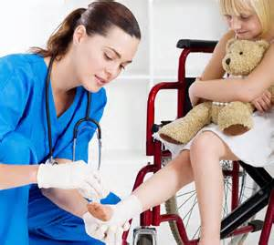
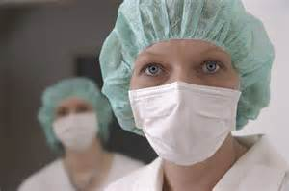
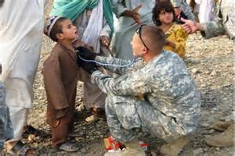
Objectives
Nursing demographics
Nursing today
Nursing degrees & salaries
Desired skills
Is Nursing for me?
How do I become a nurse?
My Story
Questions

Slide 3
Demographics
Nurses comprise the largest group of healthcare workers
2.8 million Registered Nurses in the United States
690,000 Licensed Practical Nurses
62% work in the acute care setting (hospital)
Average age of registered nurse is 45
10,000 people turn 65 every day
Nursing is listed as a top 10 hottest job
Nurses are recognized as one of the most trusted professionals

Slide 4
What is Nursing?

Slide 5
Nursing Degrees & Salaries
Nurse Practitioner 79,362 – 107,577
Masters Degree 75,546 – 90,189
Bachelors Degree 66,000 – 74,256
Associate Degree 54,080 - 65,978
Licensed Practical Nurse 34,681 – 49,354
Certified Nurses Aide 26,000 – 31,000

Slide 6
Desired Skills
Reason & Logic
Work Effectively with Others
Communicate Well
Maintain Confidentiality
Work Well Under Pressure
Critical Thinking Skills
Use Instruments & Equipment
Understand Mathematical Problems
Technology Skills

Slide 7
Is Nursing for Me?

Slide 8
How Do I Become a Nurse?
Volunteer in a health care setting
Choose a career path (ADN vs BSN)
Complete prerequisites
Apply to nursing school
Complete required courses to graduate
Take and pass State Boards
Renew license every 2 years

Slide 9
My Story
Why nursing?
Education
Employment
Current responsibilities
Future career plans
ADN 1988 Kellogg Community College
BSN 2012 - Ferris State University
MSN 2015 – Ferris State University

Slide 10
Questions

