Slide 1
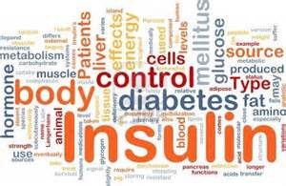
“Better Health, Better Education”
Anita Riddle, BSN, RN
Purpose
The purpose of this study is to examine the role of the school nurse as a primary and secondary health care provider, and their impact on the Type 1 Diabetic (T1DM) students’ HbA1c, compared to students receiving diabetic case management provided by unlicensed personnel.
Method
Systematic literature review
School nurses effect on T1DM students and Hba1c
Studies (n=11)
Limited research available
Background
15,600 new T1DM diagnosis annually
Many managed by unlicensed school personnel
T1DM students at risk for poor attendance, academic performance and poorly controlled Hba1c
Results
2 studies support decrease in student’s Hba1c
Decreased absenteeism, improved academics
Many positive outcomes
No significance
Implications and Implementation
6 month study designed
School nurses as diabetic case managers
Hba1c pre-study, 3 months and post study
Convenience sample
9 public school districts in Calhoun County
Conclusion
School nurses serve as primary and secondary health care providers, and have a strong potential to lower Hba1c in T1DM students.

