Slide 1
Sexually Transmitted Infections
Prevention & Treatment
Calhoun County Public Health Department
Nursing Clinic
08/15

Slide 2
Sexually Transmitted Infections

Slide 3
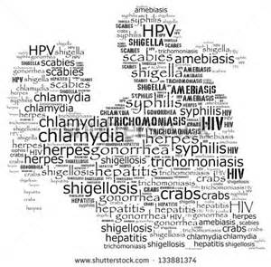
What is a Sexually Transmitted Infection or STI?
STI’s are infections that are spread from person to person through sexual contact
STI’s are dangerous because they are easily spread and it is hard to tell just by looking who has an STI.
STI’s can be bacterial, viral, or parasitic
STI’s are treatable – some may not be curable
STI’s left untreated can cause pain, sickness, infertility, birth defects, and sometimes death
STI’s may not show up until months after sexual contact with an infected partner

Slide 4
Risk Factors
Unprotected sex
Multiple sex partners
Sharing of equipment
History of STIs
Sexual assault
Being an adolescent female
Weakened immune system

Slide 5
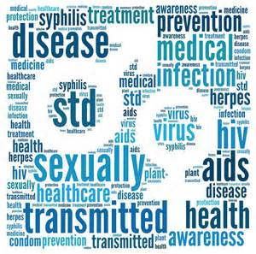
Types of STI’s
Bacterial
Chlamydia
Gonorrhea
Viral
Human papillomavirus (HPV)
Human immunodeficiency virus (HIV)
Parasitic
Trichomonas
Syphilis
Herpes Simplex
Hepatitis B, Hepatitis C
Pubic Lice

Slide 6
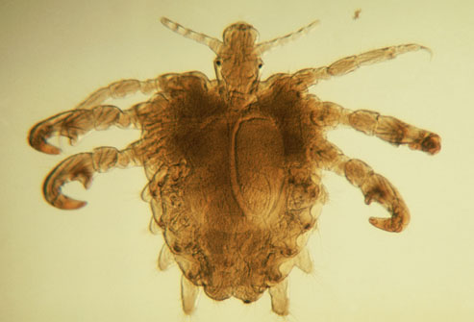
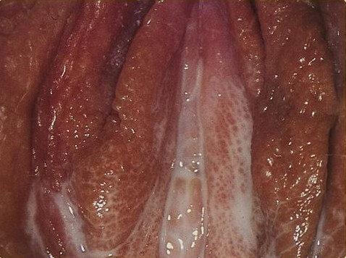
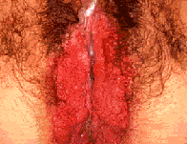
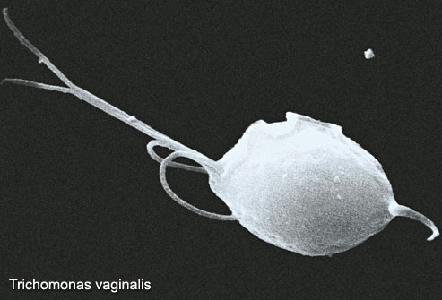
Curable
Pubic Lice
Gonorrhea
Syphilis
Trichomonas
Chlamydia

Slide 7
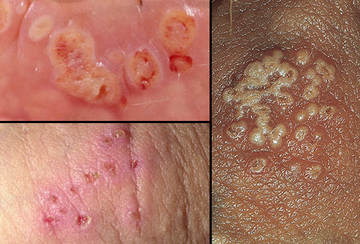
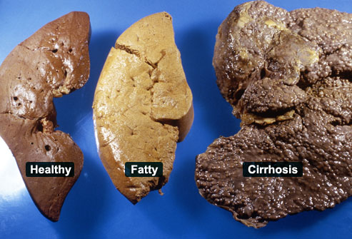
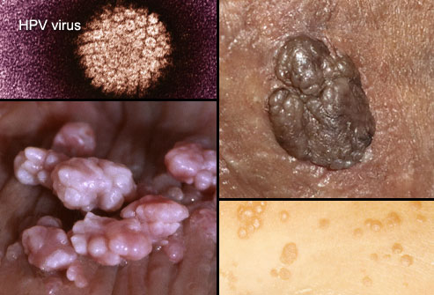
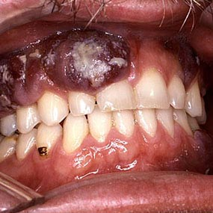
Treatable
Liver
Herpes
Hepatitis
HPV
HIV/AIDS

Slide 8
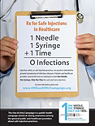
Transmission of STI’s
STI’s may be spread during these activities:
Vaginal sex
Anal sex (rectal)
Oral sex (mouth)
Skin to skin contact
Mother to baby during childbirth
Body fluids (blood, semen, vaginal fluid, breast milk)
Sharing equipment (needles, tattoos, piercings, razors)

Slide 9
Sexual Transmission
Vaginal
Anal
Oral
Skin to skin

Slide 10
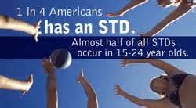
STI Symptoms
Common Symptoms
Increased vaginal or rectal discharge and/or foul odor
Vaginal itching
Burning or pain when urinating (peeing)
Need to urinate more often
Pain during sexual intercourse
Bleeding between menstrual periods
Pain in lower stomach
Warts
Fever, weight loss
Lumps, bumps, blisters, or sores on sex organs or mouth
(either painful or painless)
Sometimes no symptoms until well advanced

Slide 11
What if I Think I Have a STI?
Make an appointment with your medical care provider or local health department as soon as possible
May be tested 7-10 days after suspected exposure
Do not participate in any form of sexual activity until test results are received
Do not shave affected areas until a STI is ruled out

Slide 12
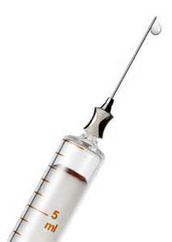
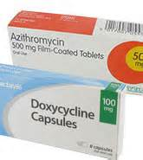
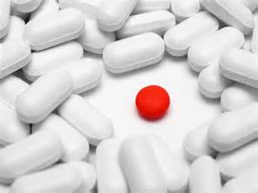
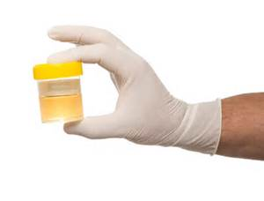
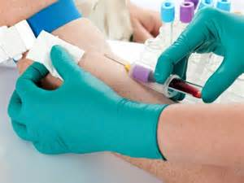
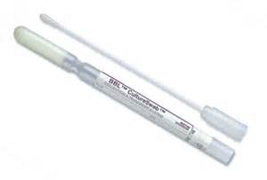
Diagnosis and Treatment
Diagnostic Methods
Swab of the infected area
Urine sample
Blood draw
Results may take several days
Treatment Methods
Antibiotics by mouth
Antibiotics by injection
Antiretroviral therapy (HIV)
Ointments
Shampoo

Slide 13
STI Treatment
Take medication as prescribed. (for multiple doses take until gone)
Do not participate in any sexual activity
Notify all sexual partners of STI and tell them to get tested
Do not shave affected areas
Get vaccinated
Ask questions
Keep follow-up appointments

Slide 14
Prevention
Abstinence (not having vaginal, anal or oral sex) is the safest way to avoid sexually contracted STIs
If you choose to be sexually active be tested for STIs along with your partner before engaging in any sexual activity
Avoid sex with multiple partners
Communicate with your partner
Inform your partner if you have a STI
Use protective barriers such as latex condoms or oral dams during sex of any type from start to finish
Avoid excessive douching
If you are sexually active and under 25, get tested annually for Chlamydia and Gonorrhea (CDC)
Get vaccinated (HPV, Hep B)

Slide 15
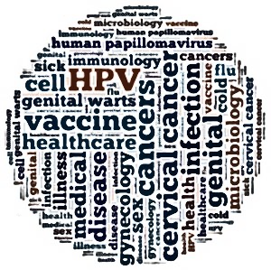
Don’t Hesitate Vaccinate!
Human Papilloma Virus (HPV) vaccine
Series of three doses over 6 month period
Recommended for all 11-12 year old males and females
Most effective if given before becoming sexually active
Females are eligible for doses up to age 26
Prevents future types of cancer
Hepatitis B (HBV) vaccine
Series of three doses over 6 months
Recommended for all ages
Prevents spread of Hepatitis B
Prevents future liver disease
Ask your nurse about your immunization history today!

Slide 16
Questions
Ask your nurse for more information!

